Slide 1
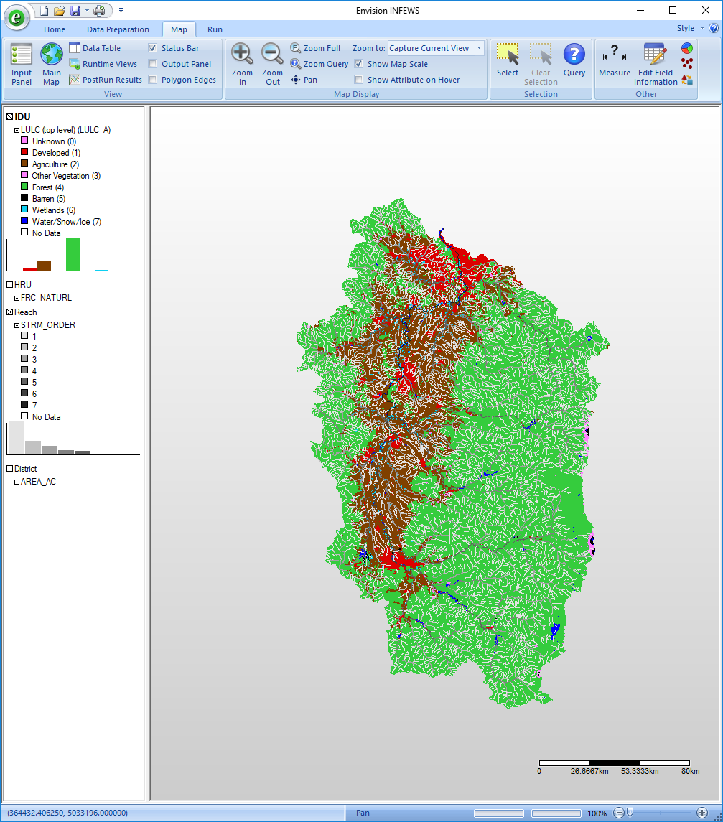
WW2100 Model Skill Assessment
David Conklin, Oregon Freshwater Simulations
March 29, 2018
Northwest Scientific Association 2018 Annual Meeting
Olympia, Washington

Slide 2
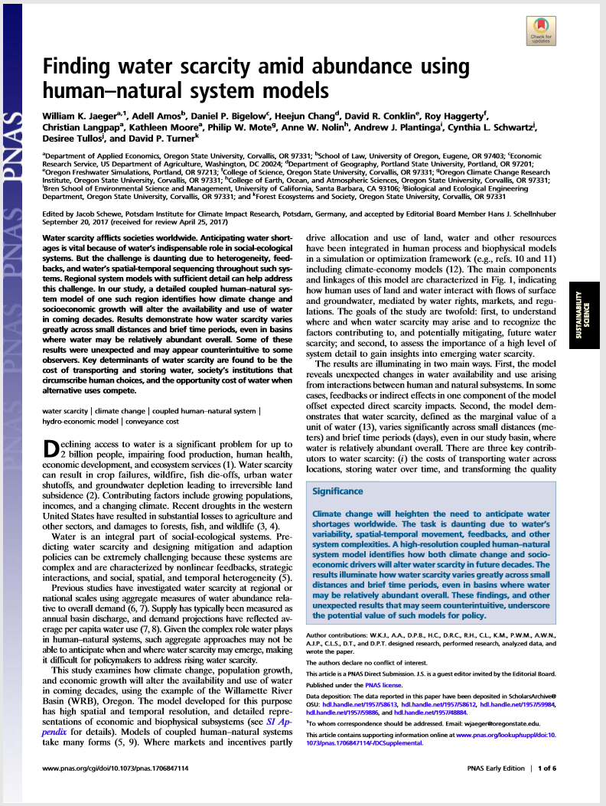
The WW2100 Project and Model
“Willamette Water 2100”: a 6-year NSF-funded project, 2011-16, at OSU, UO, and PSU.
Uses OSU’s “Envision” modeling framework
Study area: Willamette River Basin, divided into 165,000 polygons
Simulation at daily and yearly timesteps for 90 years, 2010-2099
Models daily flows in 9,000 reaches of the Willamette River and tributaries and related natural and anthropogenic processes
PNAS 2017 November, 114 (45) 11884-11889.

Slide 3
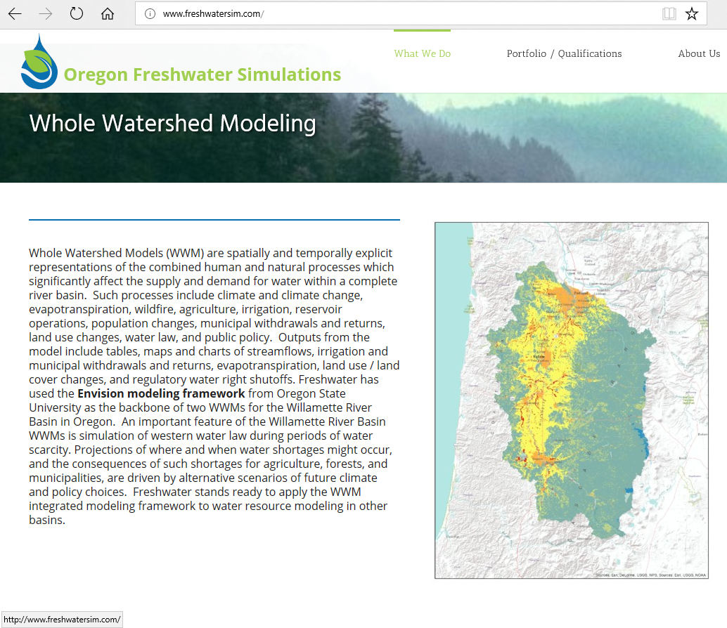
WW2100 is a Whole Watershed Model
Spatially and temporally explicit
Tries to represent all the human and natural processes
Which matter to the supply and demand for water
In a complete watershed
Closes the water budget

Slide 4
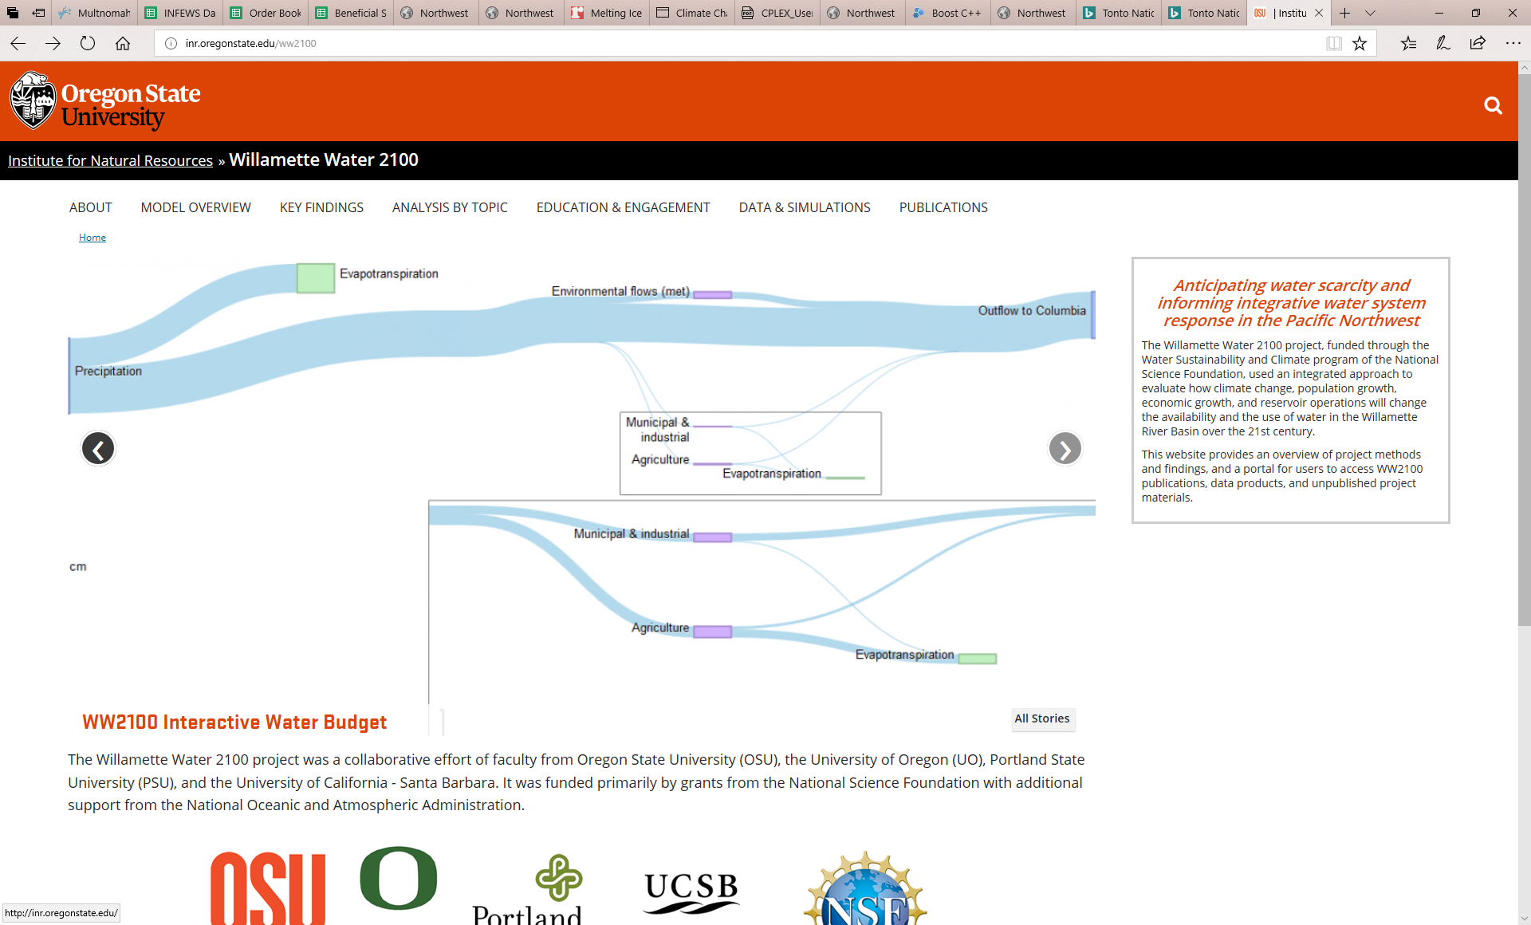
Sankey diagram from
WW2100 website
inr.oregonstate.edu/WW2100

Slide 5
WW2100 simulates many things…
Snowpack
Reservoir operations
Irrigation
Municipal water use
Forest growth, timber harvest, wildfire
Crop choice
Land use change
Evapotranspiration
…
This skill assessment focuses on streamflow

Slide 6
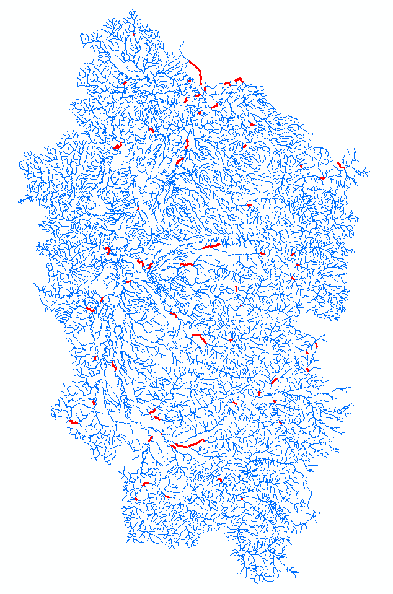
the 9,000 reaches and the 67 gages
The model simulates average daily flow in each reach
Simulated flows are compared with daily gage measurements at 67 locations

Slide 7
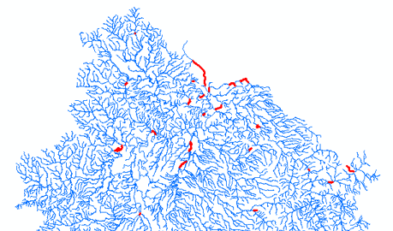
Hindcast
7 years 2010-2016
Uses historical weather records interpolated to a 4 km grid
Simulates the water budget throughout the Willamette River basin at a daily timestep
Gaged reaches in the northern Willamette basin

Slide 8
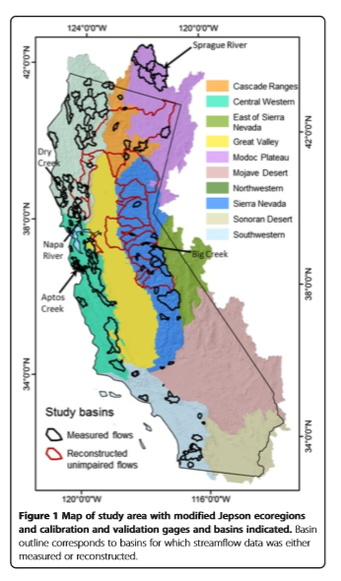
Skill assessment method as in Flint et al.
Flint LE, Flint AL, Thorne JH, Boynton R (2013). Fine-scale hydrologic modeling for regional landscape applications: the California Basin Characterization Model development and performance. Ecological Processes, 2:25.
All available gage data
Aggregated at a monthly timestep
Summary statistics formed by averaging across gage locations

Slide 9
Statistics as in the Moriasi et al. papers
Moriasi DN, Arnold JG, Van Liew MW, Bingner RL, Harmel RD, and Veith TL (2007). Model Evaluation Guidelines for Systematic Quantification of Accuracy in Watershed Simulations. Transactions of the ASABE, 50(3): 885-900.
Moriasi DN and 11 co-authors (2015a). Hydrologic and Water Quality Models: Key Calibration and Validation Topics. Transactions of the ASABE, 58(6): 1609-1618.
Moriasi DN, Gitau MW, Pai N, Daggupati P (2015b). Hydrologic and Water Quality Models: Performance Measures and Evaluation Criteria. Transactions of the ASABE, 58(6): 1763-1785.

Slide 10
Skill statistics
How well do the simulated flows reproduce the gaged flows?
Daily flows are aggregated to monthly flows
n = 84 months
Statistics are calculated for all of the 67 gaged locations for which adequate data is available
Four statistical performance measures for each month for each location:
NSE – Nash-Sutcliffe Efficiency
PBIAS – Percent bias
RSR – RMSE-observations standard deviation ratio
R² – Coefficient of determination

Slide 11
the statistical performance measures
NSE – Nash Sutcliffe Efficiency. Range +1 to –infinity. Bigger is better, +1 is a perfect match. 0 is equivalent to using the mean to predict the individual values.
PBIAS – Percent bias. Smaller absolute value is better; 0 is perfect, range is +100% to –infinity. +10% means the average of the simulated values is 10% smaller than the average of the observed values.
RSR – Ratio of RMSE to the standard deviation of the observations. Smaller is better; 0 is perfect. Range 0 to + infinity.
R² – coefficient of determination. Bigger is better; 1 is perfect. Range is 0 to 1.

Slide 12
Moriasi et al. descriptive terms
 | NSE | PBIAS | RSR | R²
Very Good | >0.80 | <+-5 | <=0.5 | >0.85
Good | >0.70 | <+-10 | <=0.6 | >0.75
Satisfactory | >0.45 | <+-15 | <=0.7 | >0.60
Not Satisfactory | <=0.45 | >=+-15 | >0.7 | <=0.60
Numerical values shown here are for monthly flow statistics

Slide 13
Example of good skill: Willamette River at Portland
Data from INFEWS 0.1
NSE | PBIAS | RSR | R²
0.87 | 0.9% | 0.36 | 0.89
Very Good | Very Good | Very Good | Very Good
Data from INFEWS 0.0

Slide 14
Example of poor skill: Johnson Creek at Milwaukie
Data from INFEWS 0.1
NSE | PBIAS | RSR | R²
0.39 | 63.5% | 0.78 | 0.92
Not Satisfactory | Not Satisfactory | Not Satisfactory | Very Good
Data from INFEWS 0.0

Slide 15
How did we do? …on all 67 gages
 | NSE | PBIAS, abs(PBIAS) | RSR | R²
Average of 67 locations | 0.36 | 4.9%, 25.4% | 0.65 | 0.82
 | Not Satisfactory | Very Good, Not Satisfactory | Satisfactory | Good
NSE | |PBIAS| | RSR | R²
0.36 | 25.4% | 0.65 | 0.82
Not Satisfactory | Not Satisfactory | Satisfactory | Good
Data is for WW2100 4.0

Slide 16
But wait… there are 10 outliers
Log scale

Slide 17
Examples of outliers
Best outlier
Worst outlier

Slide 18
How did we do? …on the remaining 57 gages after the outliers are removed
 | NSE | PBIAS, abs(PBIAS) | RSR | R²
Average of 57 locations | 0.74 | 6.6%, 16.6% | 0.50 | 0.85
 | Good | Good, Not Satisfactory | Very Good | Good
NSE | |PBIAS| | RSR | R²
0.74 | 16.6% | 0.50 | 0.85
Good | Not Satisfactory | Very Good | Good
Data is for WW2100 4.0

Slide 19
No, but wait…
How did we do on the Willamette River mainstem?
NSE | PBIAS | RSR | R²
0.85 | 6.3% | 0.39 | 0.88
Very Good | Good | Very Good | Very Good
WW2100 4.0 data for the gage in Portland
How did we do on the mainstem and major tributaries?
 | NSE | PBIAS, abs(PBIAS) | RSR | R²
Average of 25 locations | 0.77 | 10.6%, 11.4% | 0.46 | 0.84
 | Good | Satisfactory, Satisfactory | Very Good | Good
WW2100 4.0 data for the 25 gages >= 1000 cfs
How did we do on the 32 gages on smaller streams?
 | NSE | PBIAS, abs(PBIAS) | RSR | R²
Average of 32 locations | 0.71 | 3.4%, 20.8% | 0.52 | 0.85
 | Good | Very Good, Not Satisfactory | Good | Good
WW2100 4.0 data for the 32 gages < 1000 cfs

Slide 20
How do we compare to Flint et al.?
They calculated statistics for 159 gaged basins in California, compared to our 67 gages in the Willamette River basin.
They used monthly data for 30 years, 1981-2010, while we aggregated daily data by months for just 7 years, 2010-2016.
They reported NSE and R², but not PBIAS or RSR.
 | NSE | R²
Flint et al. California Basin Characterization Model | 0.67 Satisfactory | 0.73 Satisfactory
WW2100 4.0 using all 67 gages | 0.36 Not Satisfactory | 0.82 Good
WW2100 4.0 after removing 10 outliers | 0.74 Good | 0.85 Good

Slide 21
End
John Dalrymple did the lion’s share of the data-gathering, simulations, and analysis for this
study. Thank you, JD!

Slide 22
WW2100 followons
WW2100 -> OUWIN -> INFEWS
OUWIN – the Oregon part of the Urban Water Innovation Network project, now half way through a 5 year run
INFEWS – Innovations at the Nexus of Food, Energy, and Water Systems, now in its first year of a 4 year run
Both use the WW2100 model as the starting point in developing their own models of the Willamette River basin

Slide 23
We’re improving over time
Willamette at Portland
 | NSE | PBIAS | RSR | R²
WW2100 3.1 (summer 2016) | 0.78 Good | 2.7% Very Good | 0.47 Very Good | 0.78 Good
WW2100 4.0 (summer 2017) | 0.85 Very Good | 6.6% Good | 0.38 Very Good | 0.89 Very Good
OUWIN 0.0 (summer 2017) | 0.84 Very Good | 7.1% Good | 0.40 Very Good | 0.87 Very Good
INFEWS 0.0 (March 2018) | 0.87 Very Good | 0.9% Very Good | 0.36 Very Good | 0.89 Very Good
INFEWS 0.1 (March 2018) | 0.96 Very Good | -0.7% Very Good | 0.21 Very Good | 0.96 Very Good
Data aggregated to a monthly timestep

Slide 24
Analyzing the outliers
Location | Gage | Reach | issue
Middle Fork Willamette above Salt Creek | 14145500 | 23751940 | Problem w/ simulation of Hills Creek Dam?
McKenzie below Trail Bridge Dam | 14158850 | 23773359 | High Cascades groundwater?
Oak Grove Fork above power plant intake | 14209000 | 23809432
McKenzie at outlet of Clear Lake | 14158500 | 23773373 | Should be reach 23773371
Oak Grove Fork near Government Camp | 14208700 | 23810706 | Should be reach 23809450
Winberry Creek near Lowell | 14150800 | 23752606 | Should be reach 23752608
Fanno Creek at Durham | 14206950 | 23805270
Cedar Creek at Springfield | 14164700 | 23774369
Tryon Creek near Lake Oswego | 14211315 | 23815500 | Should be reach 23815506; outliers in obs?
Fanno Creek at 56th Ave | 14206900 | 23805292

Slide 25
Problem
This skill assessment focuses on streamflow.
I’m not an hydrologist.
I’m not a statistician.
I am a modeler.
When the model is ready to use, I want to know if it is any good.
Solution
Find out how hydrologists assess their own models.
Do it like that.

Slide 26
No, but wait…
Flow magnitudes range over 5 orders of magnitude
Largest flow: Willamette at Portland, 34289 cfs
Smallest flow: Nate Creek tributary near Colton, 2 cfs

Slide 27
Monthly v. Daily
Monthly time step
Average for all gages after removing 10 outliers | NSE | PBIAS | RSR | R²
WW2100 4.0 (summer 2017) | 0.74 Good | 6.6% Good | 0.50 Very Good | 0.85 Good
INFEWS 0.0 (March 2018) | 0.74 Good | 3.7% Very Good | 0.50 Very Good | 0.88 Very Good
INFEWS 0.1 (March 2018) | 0.72 Good | 3.4% Very Good | 0.21 Very Good | 0.96 Very Good
Daily time step
Average for all gages after removing 10 outliers | NSE | PBIAS | RSR | R²
WW2100 4.0 (summer 2017) | 0.44 Not Satisfactory | 6.6% Good | 0.74 Not Satisfactory | 0.51 Not Satisfactory
OUWIN 0.1 (March 2018) | 0.43 Not Satisfactory | 6.4% Good | 0.75 Not Satisfactory | 0.50 Not Satisfactory
OUWIN 0.1 (March 2018) | 0.43 Not Satisfactory | 6.4% Good | 0.75 Not Satisfactory | 0.50 Not Satisfactory

Slide 28
We’re improving over time
Average for all gages after removing 10 outliers | NSE | PBIAS | RSR | R²
WW2100 4.0 (summer 2017) | 0.74 Good | 6.6% Good | 0.50 Very Good | 0.85 Good
INFEWS 0.0 (March 2018) | 0.74 Good | 3.7% Very Good | 0.50 Very Good | 0.88 Very Good
INFEWS 0.1 (March 2018) | 0.72 Good | 3.4% Very Good | 0.21 Very Good | 0.96 Very Good
Willamette at Portland | NSE | PBIAS | RSR | R²
WW2100 3.1 (summer 2016) | 0.78 Good | 2.7% Very Good | 0.47 Very Good | 0.78 Good
WW2100 4.0 (summer 2017) | 0.85 Very Good | 6.6% Good | 0.38 Very Good | 0.89 Very Good
OUWIN 0.0 (summer 2017) | 0.84 Very Good | 7.1% Good | 0.40 Very Good | 0.87 Very Good
INFEWS 0.0 (March 2018) | 0.87 Very Good | 0.9% Very Good | 0.36 Very Good | 0.89 Very Good
INFEWS 0.1 (March 2018) | 0.96 Very Good | -0.7% Very Good | 0.21 Very Good | 0.96 Very Good

Slide 29
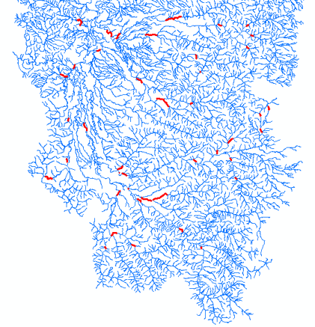
Gaged reaches in the central and southern Willamette basin

